Slide 1

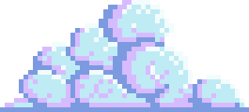



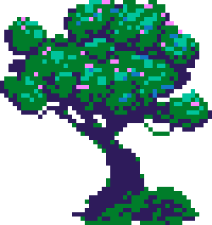



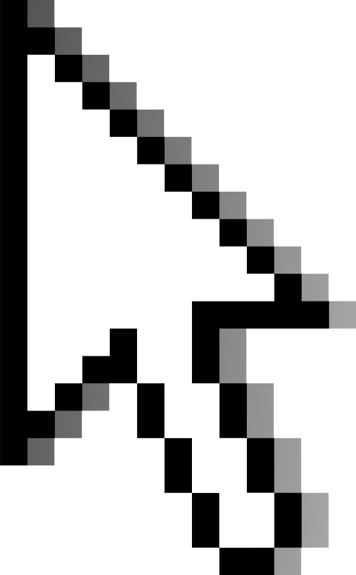

CAT
GAME

Slide 2

Meet The Team
Ibrahim Al-Zubaidi
202210902
Jana Ellayan
202311520

Slide 3
Introduction
Our fun little game is about a kitten that walks and collects coins, on its way to its house. The game implements Object Oriented Programming concepts in a creative way, meeting the project requirements while still doing things we liked.

Slide 4
Gameplay
The program begins with a welcome screen, the menu page, allowing you to either log in, sign up or view leaderboards.
Whichever you choose, you’re redirected to a page that either takes input from you or shows you the highscores.

Slide 5
Gameplay
Buttons and background are chosen in a similar color palette, making those pages visually pleasing.
These pages are connected to a database carefully crafted to store players usernames and their scores. It also updates and ranks users with each run if needed.

Slide 6
Gameplay con.
After registering, the game page starts and you can move the character forwards and backwards, and jump using WASD and space bar.
The character, a cat, was inspired by our immense love of cats. You can tell we love cats by the cute design

Slide 7
Gameplay con.
The cat’s goal is to collect maximum amount of coins and reach its home, which is where the game concludes.
Coins are strategically placed in the little game universe in a slightly challenging and significantly aesthetic way.

Slide 8
1
But where, when and how did we use OOP concepts?
2

Slide 9
In short,
1
2
3
Encapsulation is used to group the attributes and methods into units, which simplifies code maintenance and improves security - a thing we care about especially that we have a database connected.
Inheritance is implemented in classes to reuse code, establish relationships between classes, and create a hierarchy, making programs more organized and easier to maintain. For example, the coin class inherits from GameObject class.
Polymorphism allowed one interface to be used for different data types or classes, enabling methods to perform differently based on the object, improving flexibility and reusability.

Slide 10
Result
Ended up with a fully functioning 2D Platformer game, with pretty visuals and amazing database.
This project allowed us to sharpen our Java skills, as well as database, artistic, mathematical skills and get better at teamwork!
We enjoyed working on it, seeing stupid bugs and collaborating.

Slide 11
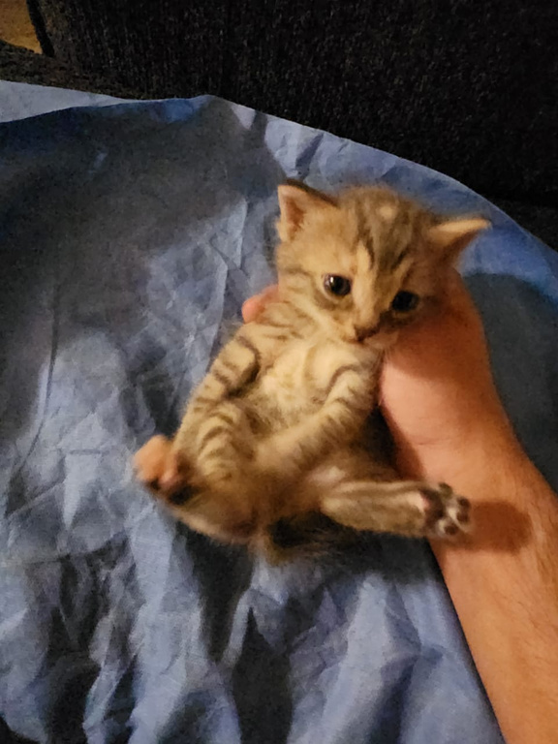
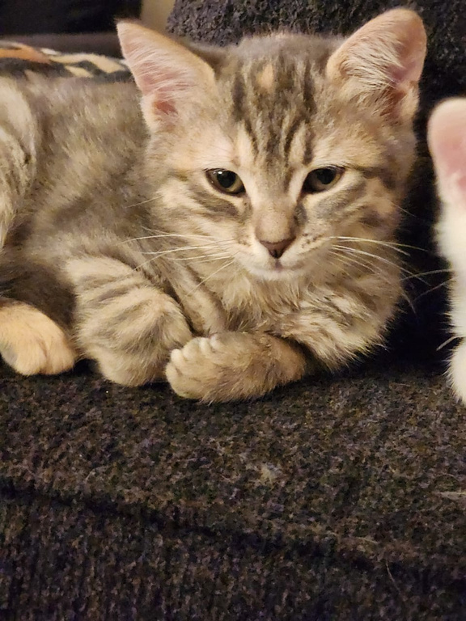
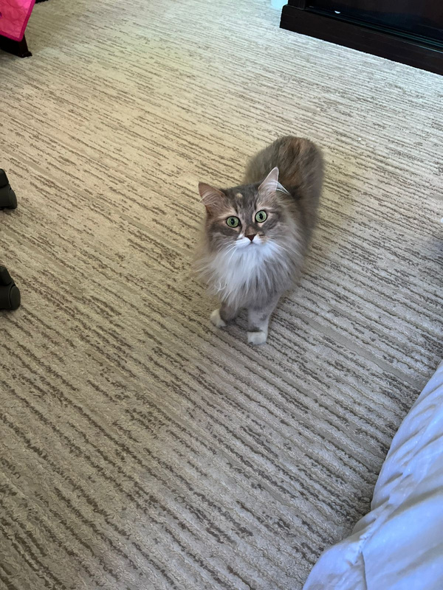
Honorable Mentions
our cats, which were our motivation for this project (alongside a deadline and some marks)

Slide 12
Thank You

